Slide 1

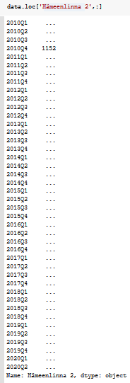


One-room flat EDA

Slide 2
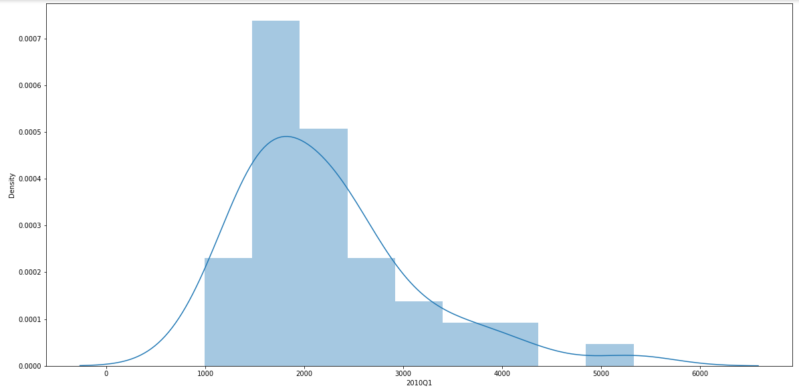
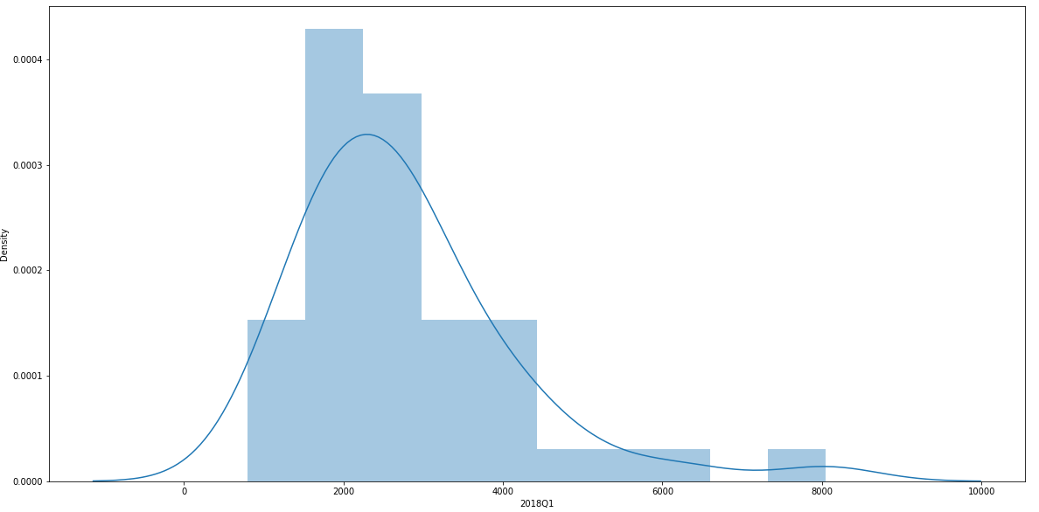
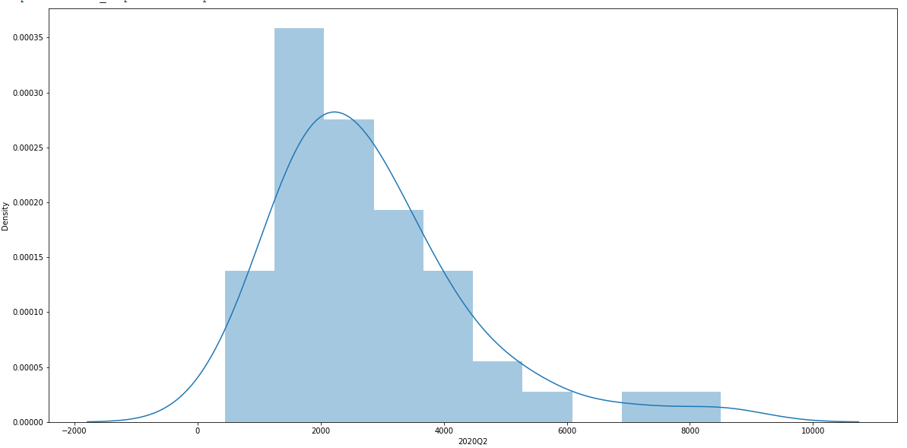
One-room flat EDA

Slide 3
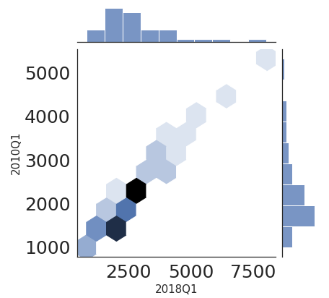
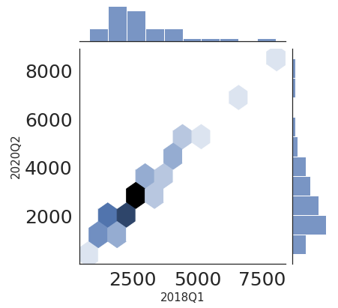
One-room flat EDA

Slide 4



One-room flat EDA

Slide 5
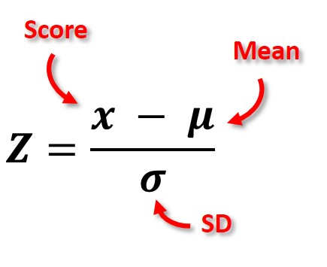

One-room flat EDA
The goal of normalization is to change the values of numeric columns in the dataset to a common scale, without distorting differences in the ranges of values.

Slide 6
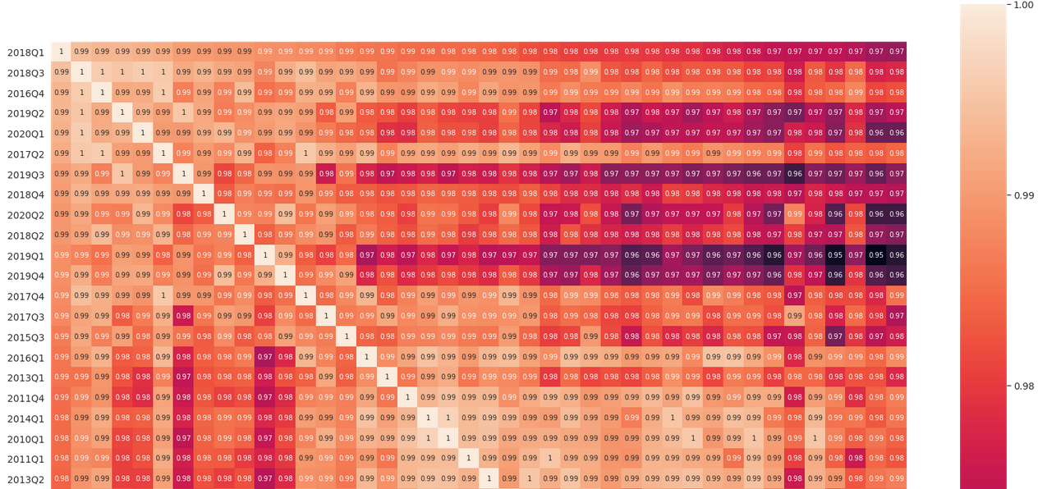
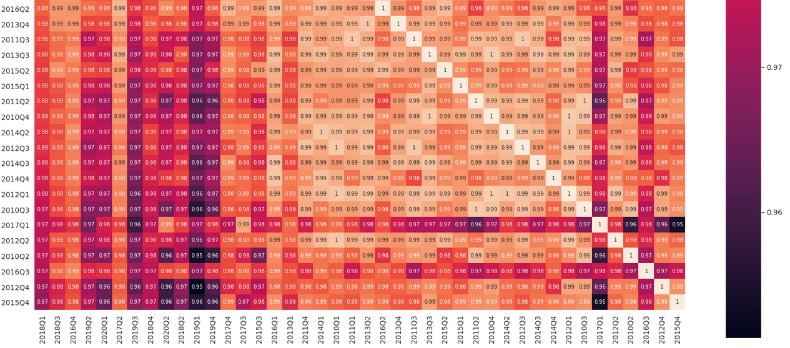
One-room flat EDA

Slide 7


One-room flat EDA

Slide 8
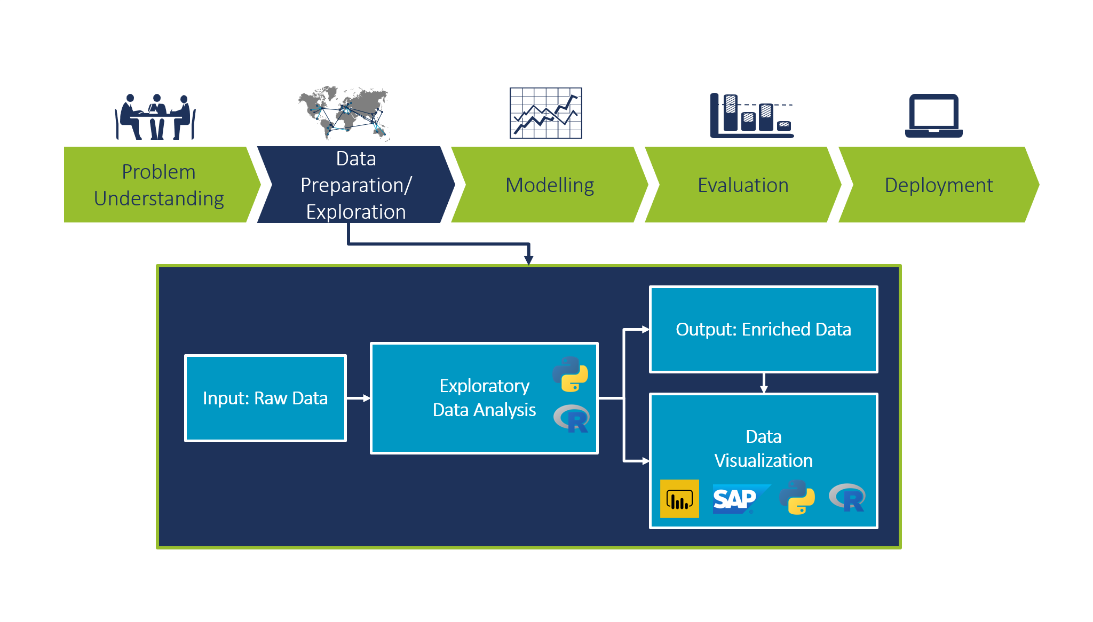
We applied the same EDA on:
Two-room flat
Three-room flat +
Terraced houses

